Slide 1


AI Observability with
Grafana Cloud and Claude Code
Notes:
Thanks for joining us for this lunch and learn. I'm [NAME] from Grafana Labs. Today we're going to show you how to add observability to your AI coding workflows. Specifically, we'll instrument Claude Code with OpenTelemetry tracing and visualize everything in Grafana Cloud. As you can see we've got Claw'd and Grot teaming up for this one – Anthropic's AI meets Grafana's observability platform. By the end of this session you'll have real traces from your own Claude Code sessions flowing into a dashboard you can keep.

Slide 2
Why Tracing Matters for AI Agents
Beyond Text Generation: Tools like Claude Code perform active operations such as file I/O, bash commands and API searches.
Hidden Complexity: A single user prompt can trigger dozens of underlying tool calls invisible to the end user.
Full Visibility: Tracing reveals exactly what the agent did, step-by-step latency, and specific success/failure points.
Industry Standards: Uses OpenTelemetry (OTel), the same open standard used for modern microservices.
Real-Time Insight: Today, we hook Claude Code's tool calls directly into Grafana Cloud for live monitoring.
Notes:
So why do we care about tracing an AI agent? When you give Claude Code a prompt, it doesn't just spit out an answer. It makes tool calls — reading files, running shell commands, searching code, making edits. A single prompt can kick off dozens of these behind the scenes. Without tracing, that's a black box. With tracing, you get full visibility: what tools were called, in what order, how long each one took, and whether it succeeded or failed. This is the same OpenTelemetry standard you'd use to instrument a microservice — we're just pointing it at an AI assistant instead.

Slide 3
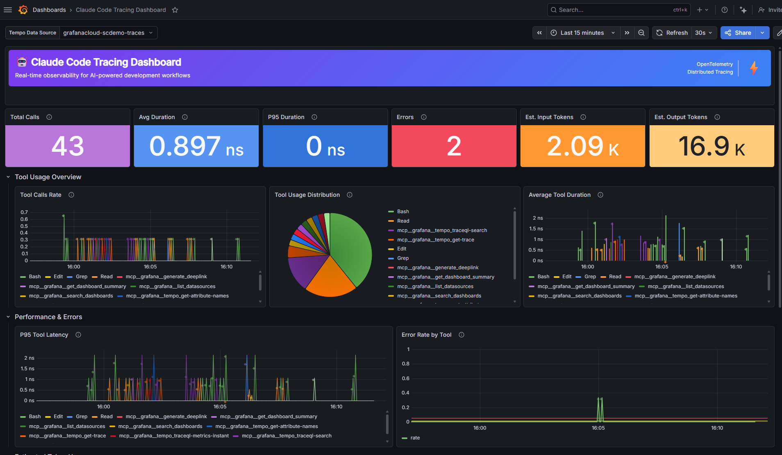
Notes:
Here's what it looks like in practice. This is a Grafana dashboard pulling trace data from your Claude Code session in real time. Each span is a tool call — you can see the tool name, duration, and status. You'll build this yourself in the hands-on portion. The dashboard JSON is included in the repo, so you just import it and go.

